Slide 1
Behavioural Science:
Understanding and Developing Self

Slide 2
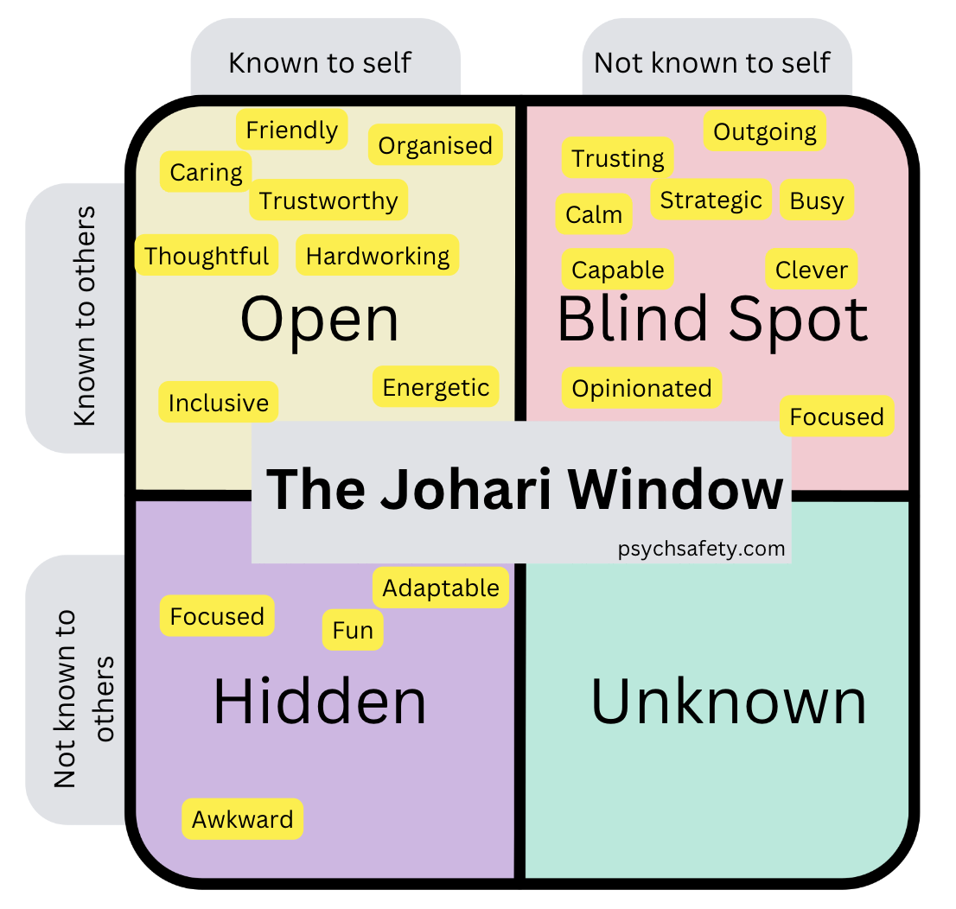
Joseph Luft and Harry Ingham

Slide 3
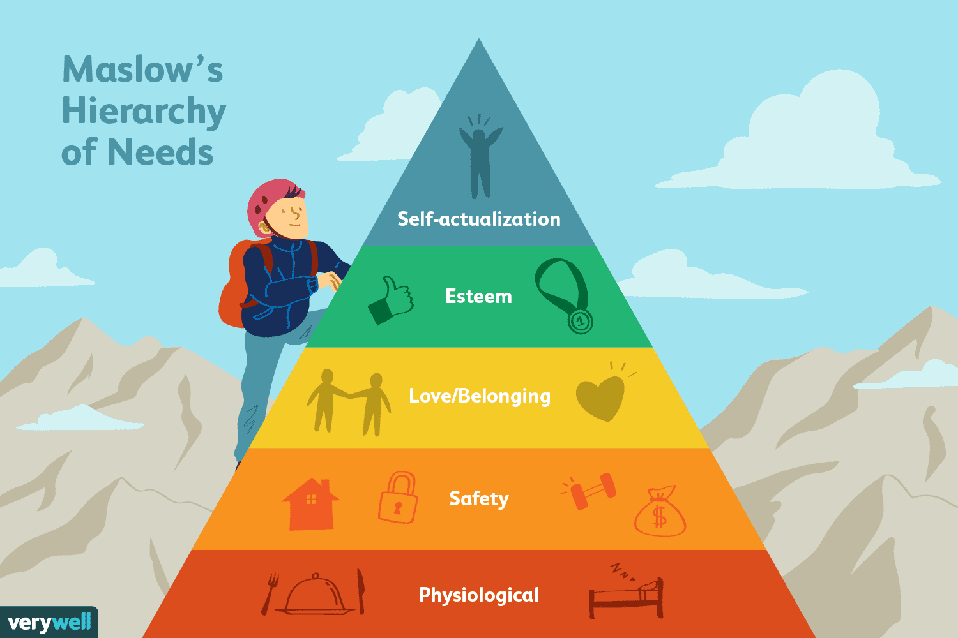

Slide 4
Knowing the Self
EXERCISE-01: Self Test about the Self
Do we all know our abilities/inabilities; Strengths/Weaknesses; Priorities?
There are as many as 27 practical questions in EXERCISE SHEET-01. Please answer the questions and test the extent you know about yourself.
For each question, please write the first answer that instantly pops up in your mind (don’t say “I don’t know”).
Please note, answers will vary person to person and there is no right or wrong answer to each question.

Slide 5
Knowing the Self
EXERCISE-02: Assessment of Individual Skill
In the process of our development as human being we acquire both soft and hard skills.
Soft skills (eg. negotiation, communication) are developed over the years through our experience, practices and interactions with others.
Hard skills (eg. computer literacy, project management) are related to our knowledge which we learn through education, training, etc.
We have listed 15 skills in EXERCISE SHEET-02. Please rank order these skills, giving priority to those you do/are best (1 being the highest)

Slide 6
Knowing the Self
EXERCISE-03: Understanding Individual Behaviour
Soft skills are related to human behaviour and reflected through observable actions, reactions and responses to different situations and environments. It includes what people do, think and feel in daily life.
Some people are very social and take huge social responsibility while some others are very individualistic. These are behavioural dimension.
We have listed 14 behavioural dimensions in EXERCISE SHEET-03. Please rank order (1-14) these behaviors, starting with those you are best at (1 being the highest)

Slide 7
Knowing the Self
EXERCISE-04: Assessment of Personal Values
Our behavioural demonstrations are guided by individual values and we feel better if we are living according to our values and feel worse if we don’t.
We have many values but some of which are most important to us, often motivate us and guide our decision making in all aspects.
The attributes (obviously not inclusive) listed in EXERCISE SHEET-04 is often identified as personal values. Please assess the importance of these values in terms of priority. (5=very important; 4=important; 3=somewhat important; 2 =not important; 1=definitely not important)
Identify your 05 core values from among your very important values.

Slide 8
Knowing the Self
EXERCISE-05: Assessment of Personality Type and Temperament-MBTI
You have defined five core values that you value the most in your individual life. All these values are linked to your personality type.
Each of us has a unique personality which gives clues about how we are likely to act and feel in a variety of situations.
Personality type and temperament reflects how a person usually thinks, feels, and behaves/how people deal with others, handle pressure, make decisions, and work in different situations.

Slide 9
Knowing the Self
EXERCISE-05: Assessment of Personality Type and Temperament-MBTI
How do we relate to and interact with the world around us?
More frequent social interaction (External) or love spending time alone (Internal).
How do we gather information from the world around us?
Focus on facts and small details or possibilities and imagination (Big picture)
How do we make decisions based on information collected?
Logical and impersonal or guided by emotions
How do we deal with the outer world?
Prefer firm decisions (Structured) or more open and flexible

Slide 10
Knowing the Self: Personality Type
Swiss psychologist Carl G. Jung introduced three mental bipolar dimensions (dichotomies) in his approach to personality:
a. Extroversion (E) and Introversion (I) -Orientation of energy- External-gain energy from social interaction and group activities/Internal-gain energy from quiet thinking and working independently.
b. Sensing (S) and Intuition (N)-Information-gathering style- Detail-Oriented-carefully checks statistics and previous records/Big-Picture Style-focus more on general ideas, patterns, and future possibilities, long-term impact rather than small details.
Thinking (T) and Feeling (F)-Decision-making approach-Logical, based on facts, data, and careful analysis/Emotional-based on feelings, values, and the impact on others when making decisions.
Isabel Myers and Katherine Briggs proposed the fourth dichotomy that also influences the characteristics of personality type:
Judging (J) and Perceiving (P)-Lifestyle organisation preference (Structured Preference-clear plans in advance, schedules and orders)/Flexible Preference-prefer freedom and adaptability rather than strict planning.

Slide 11
Personality Type and Temperament Questions
Where, primarily, do you direct your energy? (E)xtraversion vs (I)ntroversion
To the outer world of activity, and spoken words (E)
OR
To the inner world of thoughts and emotions (I)
MY LETTER CHOICE IS E / I
2. How do you prefer to process information? (S)ensing vs. i(N)tuition
In the form of known facts and familiar terms (S)
OR
In the form of possibilities or new potential (N)
MY LETTER CHOICE IS S / N

Slide 12
Personality Type and Temperament Questions
3. How do you prefer to make decisions? (T)hinking vs. (F)eeling
On the basis of logic and objective considerations (T)
OR
On the basis of personal values (F)
MY LETTER CHOICE IS T / F
4. How do you prefer to organize your life? (J)udgement vs. (P)erception
In a structured way, making decisions and knowing where you stand (J)
OR
In a flexible way, discovering life as you go along (P)
MY LETTER CHOICE IS J / P

Slide 13
Personality Type and Temperament Questions
As I conclude, my Four-letter Choice is:
E or I | ?
S or N | ?
T or F | ?
J or P | ?

Slide 14
The 16 Personality Types
SJ GUARDIAN | SP ARTISAN | NT RATIONALIST | NF IDEALIST
ESTJ (SUPERVISOR) | ESTP (PROMOTER) | ENTP (INVENTOR) | ENFP (CHAMPION)
ISTJ (INSPECTOR) | ISTP (CRAFTER) | INTP (ARCHITECT) | INFP (HEALER)
ESFJ (PROVIDER) | ESFP (PERFORMER) | ENTJ (FIELD MARSHAL) | ENFJ (TEACHER)
ISFJ (PROTECTOR) | ISFP (COMPOSER) | INTJ (MASTERMIND) | INFJ (COUNSELOR)

Slide 15
Common characteristics of each type of people (Sheet-01)

Slide 16
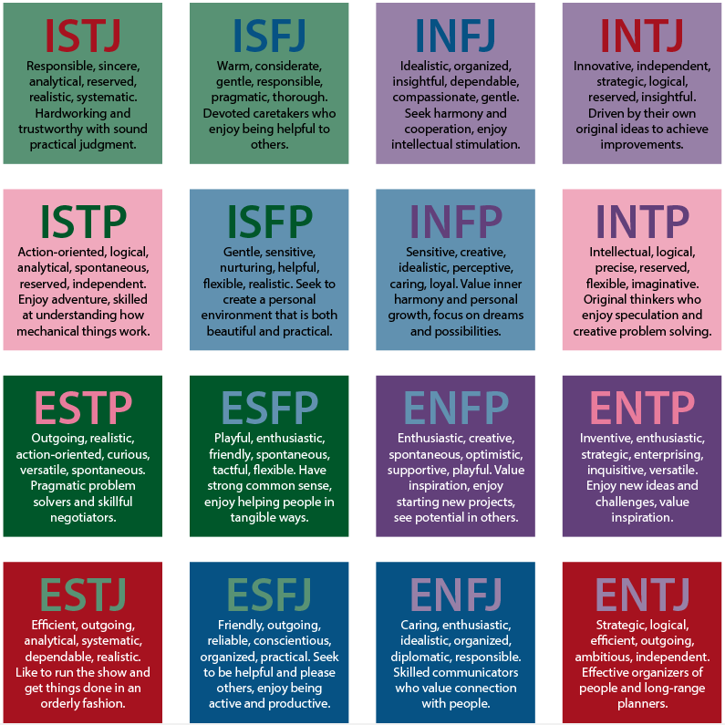
Personality Types Description (Sheet-02)

Slide 17
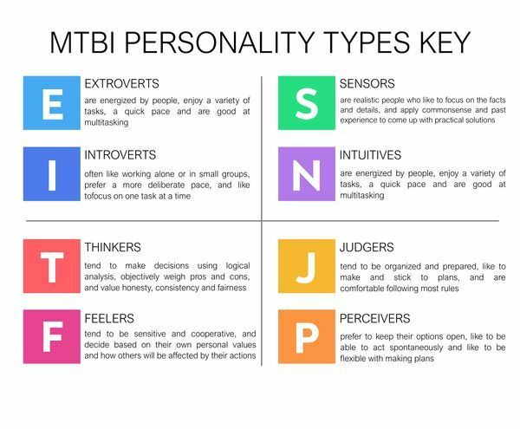
Personality Types and Strengths/Weaknesses of Dimensions (Sheet-03)

Slide 18
Possible Strengths and Weaknesses of TYPES (Sheet-04)

Slide 19
Final Exercise (Individual Thinking)
Individual Observation about Personal Weakness?
What needs to be done to overcome Personal Weakness?

Slide 20
Is it possible to change your personality type?
How to address weaknesses?
Our basic personality type cannot be changed
The environment we are in shapes our personality in a certain way, forcing us to develop traits and habits that might be foreign to our type.
We can (and should) change the aspects of our personality that we are unhappy with.
This will strengthen our shadow traits and help become a more well-rounded individual, even though our dominant traits will still remain the same.
Such a change could be triggered by either the environment we are in or our own will to each us own.

