Slide 1


Date: January 26, 2025 (10.00AM-1.00PM)
Excusive Lecture for
Railway Training Academy, Chattogram
On
Transport GEOGRAPHY
Dr. Razon Chandra Saha
PhD in Transport(BD), Postdoc(Malaysia), MBA in Maritime Mgt.(UK),BSc in Nautical Science
Freight Transport Specialist, Poraka Innovation, Bangladesh.
Adjunct Faculty, Malaysia University of Science and Technology, Malaysia.
Maritime Consultant-Bangladesh - Drewry Maritime Advisory Pte Ltd., Singapore.
Mobile/WhatsApp # +8801712101630, E-mail. razon864@yahoo.com
Web. https://razonchandrasaha.blogspot.com

Slide 2
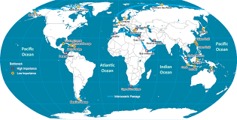
Outline of the Lecture
Mobility and Geography.
Transport Geography.
Transport Sector and Network of Bangladesh.
Key Concepts in Transport Geography.
Nature and Importance of Transport Geography.
Transportation Systems.
Transportation, Economy and Society.
Challenges for Transport Geography.
Future Transportation Systems.
Rail Transportation Systems.
Global Freight Transportation Systems.
Key Learnings and Knowledge Management.
Schedule
Lecture-90 Mins
Refresh-10 Mins
Case Study-40 Mins
Group Presentation-20 Mins
Q &A-20 Mins

Slide 3
Mobility and Geography
Mobility has always been a fundamental component of the economic and social life of societies.
Contemporary economic processes have been accompanied by a significant increase in mobility and higher levels of accessibility.
A historical perspective on the evolution of transport systems underlines the impacts of technological innovations and how transportation improvements were interdependent with economic, social, and spatial changes.
Thus, the current transport systems are the outcome of a long historical evolution marked by periods of rapid changes where new transport technologies were adopted.
Following the Industrial Revolution in the 19th century, transportation systems were mechanized with the development of steam engine technology, which permitted the setting of networks servicing regions.
This process was further expanded in the 20th century with global air transport, container shipping, and telecommunication networks.
However, this requires the capacity to manage, support, and expand the mobility of passengers and freight as well as their underlying information flows. Societies have become increasingly dependent on their transport systems to support a wide variety of activities, ranging from commuting, tourism, supplying energy needs, and distributing parts and final goods.
Developing transport systems has been a continuous challenge to satisfy mobility needs, support economic development, and participate in the global economy.

Slide 4
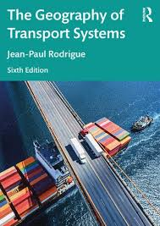
Transport Geography
Transport geography is a sub-discipline of geography concerned with the mobility of people, freight, and information and its spatial organization. It includes attributes and constraints related to the origin, destination, extent, nature, and purpose of mobility.
Transport geography can be understood from a series of eight core principles:
Transportation is the spatial linking of derived demand.
Distance is a relative concept involving space, time, and effort.
Space is concomitantly the generator, support, and constraint for mobility.
The relation between space and time can converge or diverge.
A location can be central, generating and attracting traffic, or
an intermediate element where traffic transits.
To overcome geography, transportation requires a footprint.
Transportation seeks massification but is constrained by atomization.
Velocity is a modal, intermodal, and managerial effort.

Slide 5
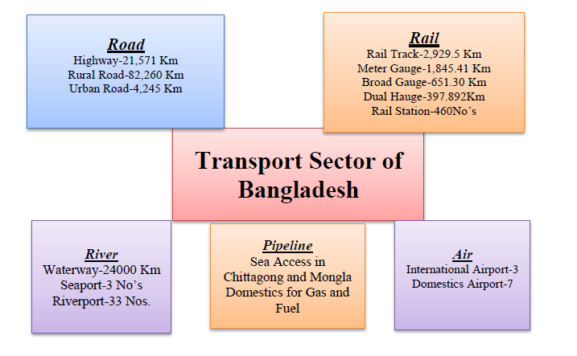
Transport Sector of Bangladesh

Slide 6
Transport Network of Bangladesh
Intermodal Network of Bangladesh

Slide 7
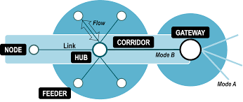
Key Concepts in Transport Geography
Nodes:
These are key locations where transport
flows begin, end, or are transferred between
different modes, such as ports, airports, and railway stations.
Networks:
This refers to the physical structures, like roads,
railways, and shipping lanes, that support and guide movement between different nodes.
Demand:
This encompasses the reasons and desires for people and goods to move, as well as the modes and volumes of transport required to fulfill those needs.

Slide 8
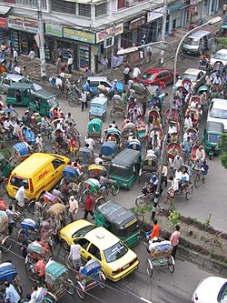
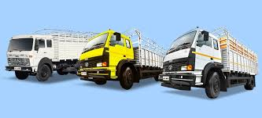
Key Concepts in Transport Geography 2/2
Modes:
Ways to mode one node to another's. Fortunately, Bangladesh belongs to all modes of transport.
Carrier:
Operator of transport.
Supply:
Facilities developed against the demand.

Slide 9
Nature and Importance of Transport Geography
Nature:
Spatial Science: It is a spatial science because it deals with movement across space and how varying landscapes and distances influence these movements.
Multidisciplinary: Transport geography draws on insights from economics, engineering, and management, integrating them to provide a comprehensive understanding of transport systems.
Positivist Approach: It often uses data collection and analysis to develop and test models that explain patterns of transportation and their spatial relationships.
Importance :
It highlights the interconnectedness of geographical factors with transportation, showing how space influences transport and vice-versa.
It is crucial for understanding historical development, social dynamics, political influences, economic activities, and environmental impacts associated with mobility.

Slide 10
Transportation Systems
Rodrigue (2024),
Rodrigue ,2024).

Slide 11
Transportation, Economy and Society
Transport systems, by the mobility they provide, are closely related to socioeconomic changes.
Economic opportunities will likely arise where transportation infrastructures can ensure access to markets and resources.
From the industrial revolution in the 19th century to globalization and economic integration processes of the late 20th and early the 21st centuries, world regions have been affected differently by economic development.
International, regional, and local transportation systems have become fundamental components of economic activity. A growing share of the wealth is thus linked to trade and distribution.
However, even if transportation positively impacts socioeconomic systems, there are also negative consequences, such as congestion, accidents, and mobility gaps.
Transportation is also a commercial activity that benefits from operational attributes such as costs, capacity, efficiency, reliability, and speed.
Transportation systems are evolving within a complex set of relationships between the transport supply, reflecting the operational capacity of the network, transport demand, and the mobility requirements of an economy.

Slide 12
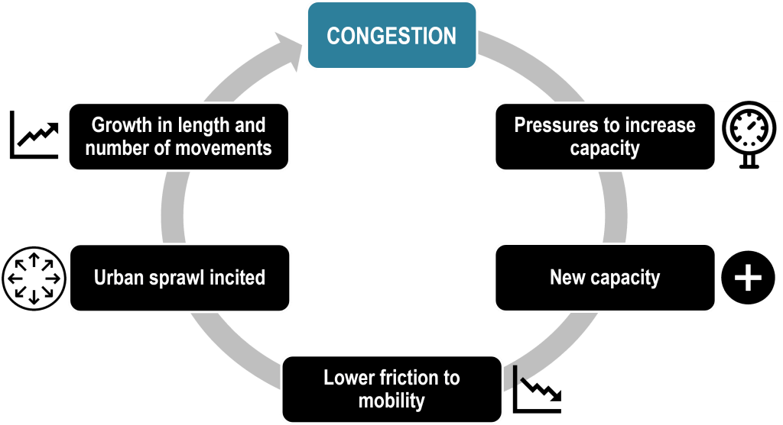
Challenges for Transport Geography
Transport geography seeks to understand the spatial organization of mobility.
It has emerged as a full-fledged field within geography with a strong propensity to include concepts and methods from other disciplines such as economics, engineering, environmental sciences, and sociology.
Transportation is growing significantly and changing in the face of challenges and drivers of change, such as sustainability, congestion, governance, and technology.
As the transport industry becomes more complex, conventional approaches, focusing on a narrow range of factors, have to be replaced by more nuanced analysis and solutions.
Further, issues related to freight mobility are assuming greater importance within the discipline, partly driven by the setting of global supply chains and the growth of urban freight distribution.

Slide 13
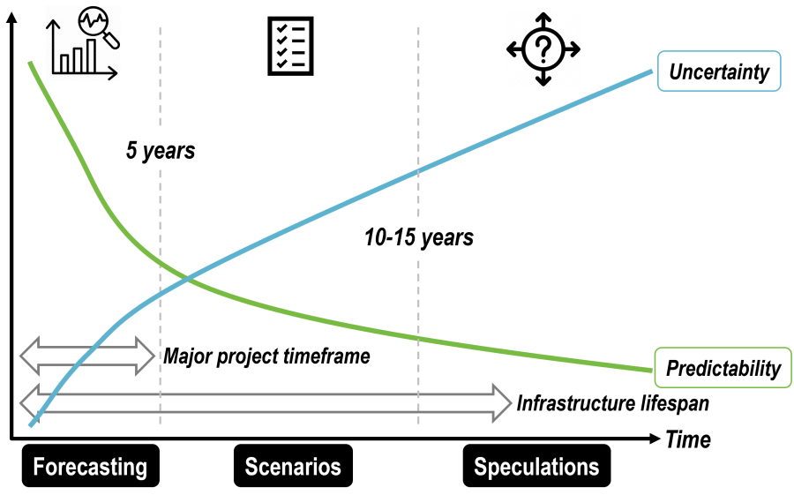
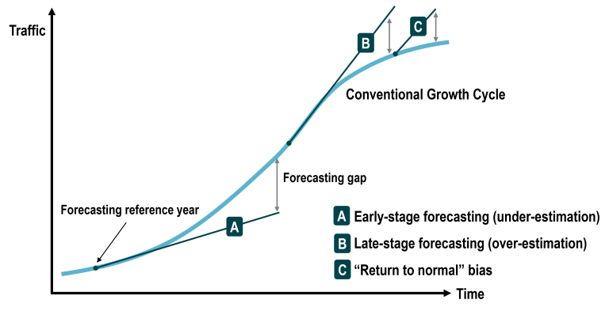
Future Transportation Systems
Transportation changes are either incremental or revolutionary. The future of transportation will be influenced by a higher integration between physical and information systems.
Past Trends and Uncertain Future
Automation and Information Technologies
Alternative Modes and Fuels
Drivers of Change

Slide 14
Rail Transportation Systems

Slide 15
Railways as a Key Part of Integrated Transport Systems
Railway always denoted as a key transport managed by the government.
Rail transportation systems are networks for moving passengers and freight via trains, ranging from urban commuter lines to high-speed intercity services and extensive freight networks.
Key features include their high energy efficiency, reduced environmental impact compared to road transport, and capacity for moving large volumes of goods over long distances economically.
These systems involve specialized infrastructure like tracks, vehicles, and control systems, with continuous innovation focusing on safety, operational efficiency, and integration into broader transport networks
Advantages and Trends
Economical for Bulk Transport: A primary advantage for transporting large volumes of goods over long distances.
Sustainability: Contributes to lower environmental degradation and reduced external costs.
Integration: Modern systems aim to be an integral part of wider transport networks, providing seamless connections.
Innovation: Ongoing developments in high-speed technology, safety features, and operational flexibility through technologies like containerization are crucial trends.

Slide 16
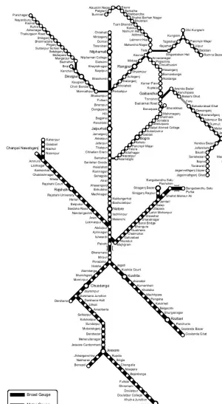
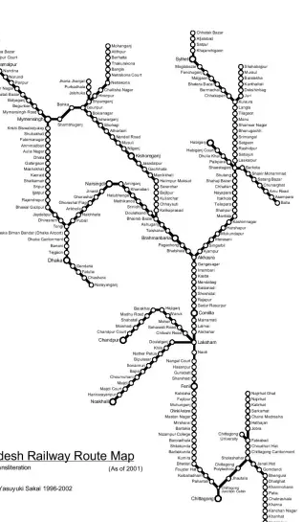
Rail Transport Network
Zones
Stations
Broad-gauge
Meter gauge
Dual Gauge
Where to work?

Slide 17
Freight Transportation Systems

Slide 18

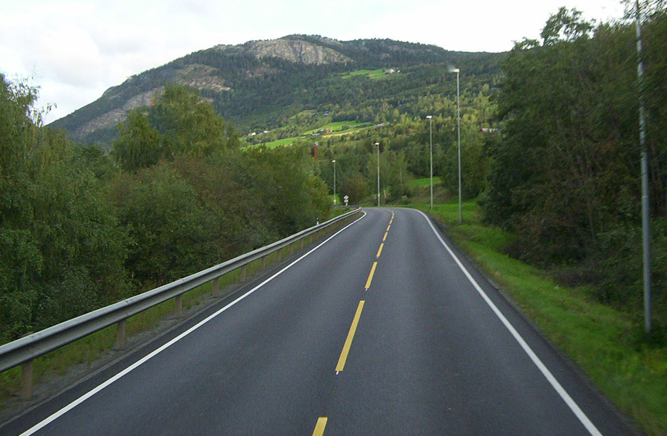

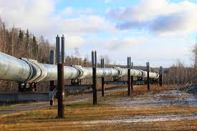
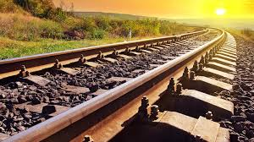
Last mile
Last mile
Last mile
Passage
Mode ( Water, Air, Road, Rail and Pipeline)
Last mile
Node( Seaport, Airport, River Port, Land Port, Pipeline Station/Port)
Node( Seaport, Airport, River Port, Land Port, Pipeline Station/Port)
Last mile
Last mile
Last mile
Last mile
Freight Transport Geography

Slide 19
Break Bulk
Specialized Ship
Container
Synchromodal
Chemical
Unimodal
Multimodal
Intermodal
UNCTAD reported in the last 20 years, more than 90% of international cargo moved by SEA.
Liquid Carrier
Gas (LNG/LPG)
What????
Others
Ro-Ro
  Maritime Transportation

Slide 20
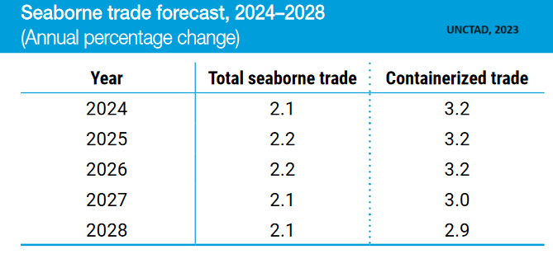
Importance of International Shipping
Maritime transport is the backbone of international trade and the global economy.
Over 80% of the volume of international trade in goods is carried by sea, and the percentage is even higher for most developing countries (RMIT, 2021).
Very negatively, in 2023, carbon emissions from international shipping were 20 percent higher than ten years.
International shipping is facing the advancement of digitalization.
Maritime logistics is increasingly dependent on more efficient ports and digitalized processes.
While the COVID-19 pandemic deeply disrupted global supply chains and logistics, the shipping industry served restlessly.
The maritime trade volumes will continue to grow for the foreseeable future – 2.4 percent in 2023,and 2. 1 percent over the next five years.
There will be a balance in 2027 and will decline only in the containerized trade.
Hope to see a new scenario after Wars in different parts of the world.

Slide 21
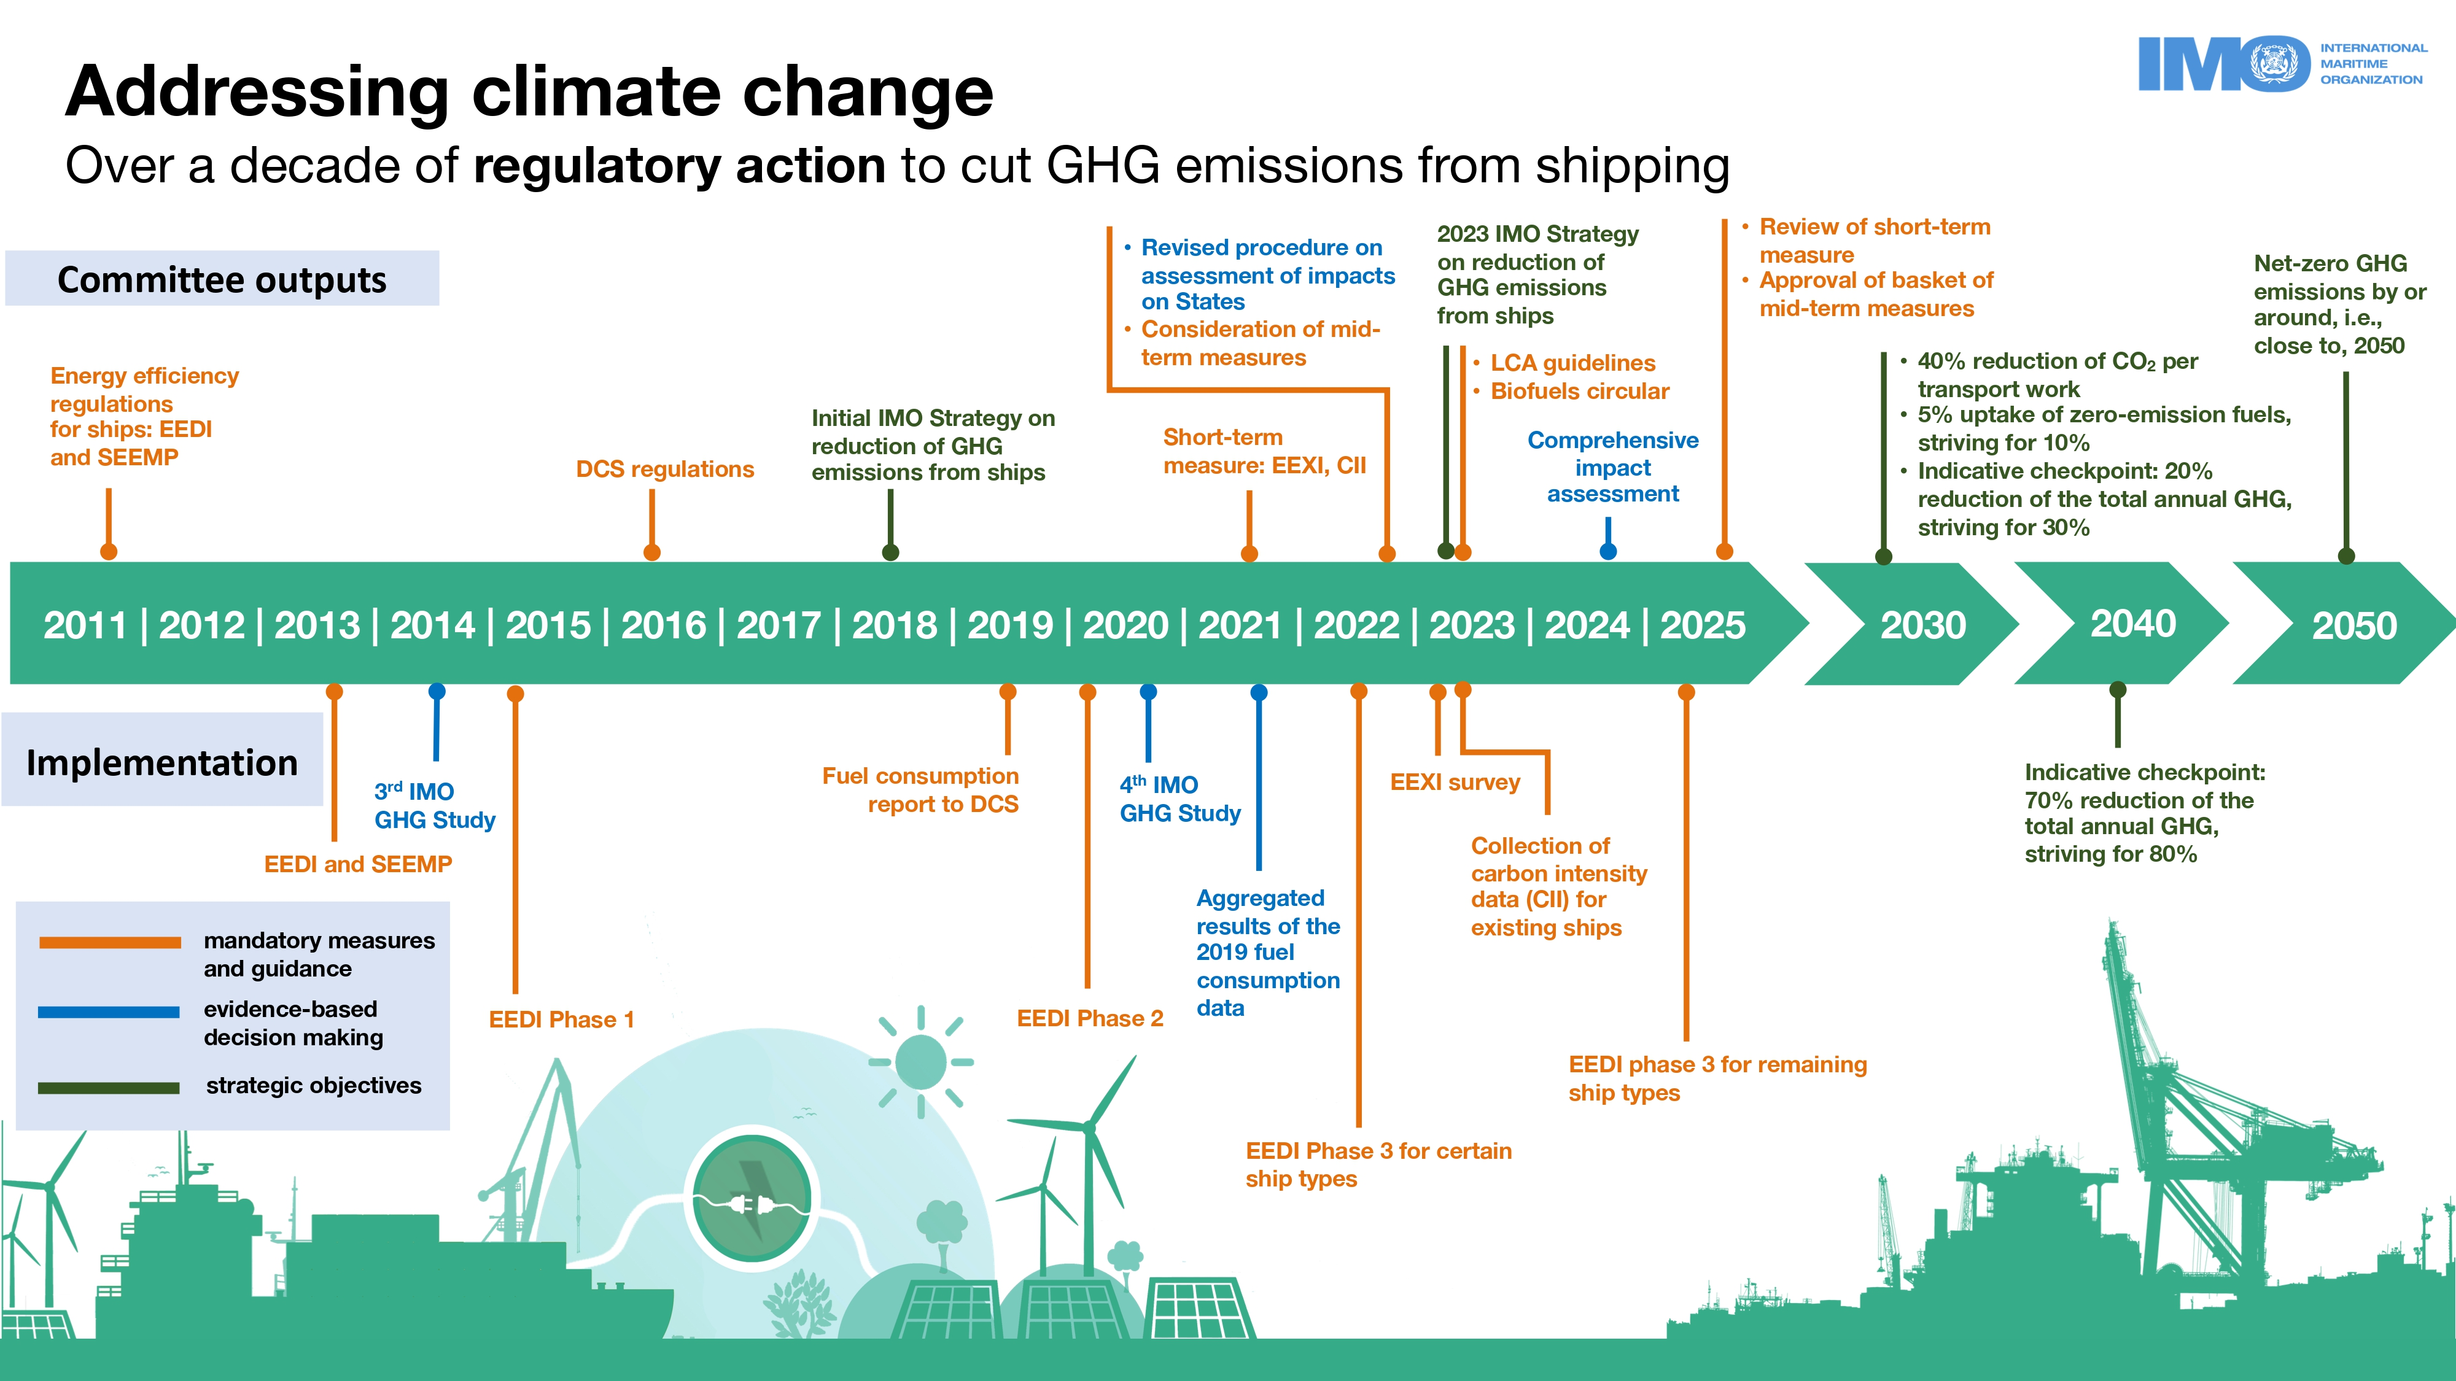
Decarbonization of the Shipping Industry

Slide 22
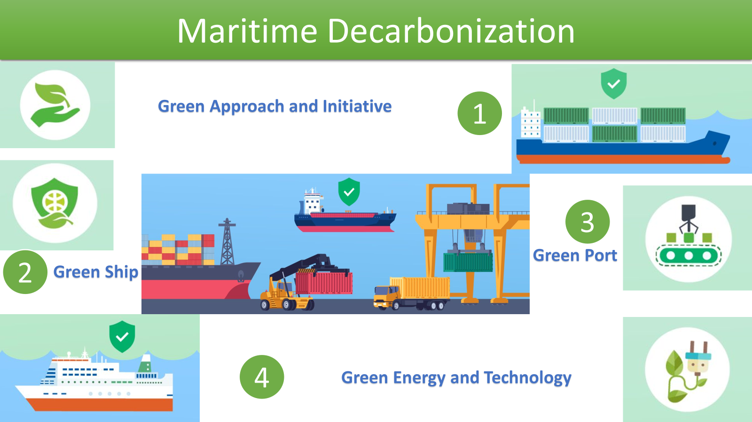

Slide 23
History of Containerization
In 1956, an entrepreneurial trucker named Malcolm McLean, seeking a cost-effective alternative to move cargo between New Jersey and Texas loaded 58 trailer bodies onto the World War II vintage tanker, the TS Ideal X, marking the start of what we call "Containerization.
From this humble beginning, the container industry has evolved into a sophisticated global transportation system with a volume exceeding 100 million units of containerized cargo annually.
To support this containerized system, over 37 million TEUs move in more than 19 million vessel slots and transit on roads, railways, and waterways throughout the world carrying a diverse mix of cargo in a safe, secure, efficient, and environmentally responsible manner.
The efficiency of containerization for transporting consumer goods and certain raw materials has facilitated the growth of international trade. Significant efficiencies in packaging and handling have increased productivity and reduced damage that has resulted in significant growth in volumes.
No doubt, the Container transportation system changed the freight movement style globally.

Slide 24
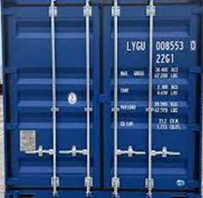
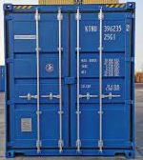
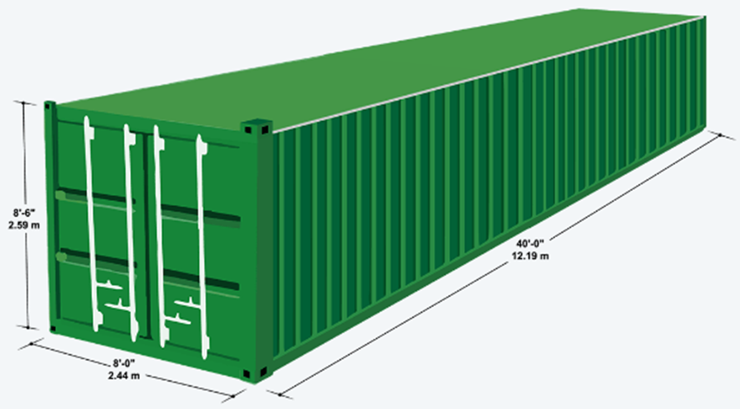
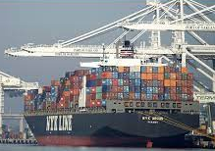
Container –A Box for Global Transportation
Size | Purpose | Remarks
20” | General | High Load
40” | General | Average Load
40 HC | High Cube- Exclusive | Average Load and Volume
45” HC | High Cube- Extra-Ordinary-RMG | High Volume

Slide 25
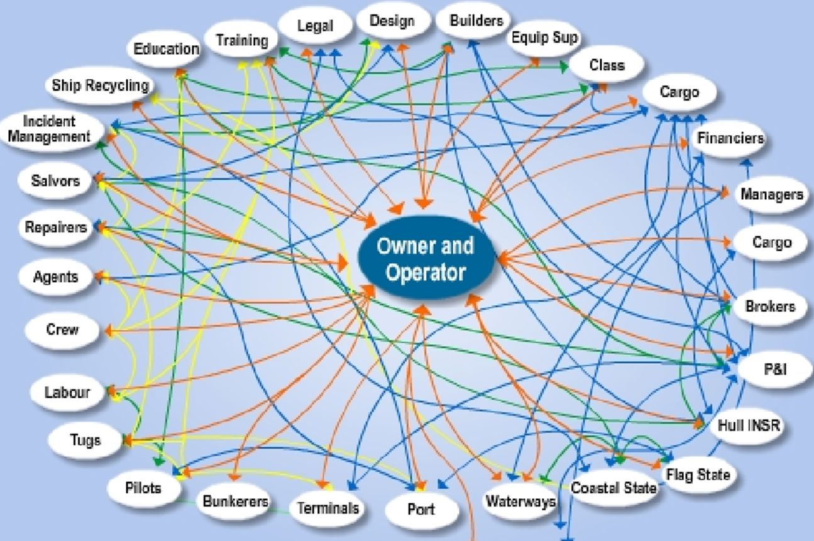
Actors and Activities in the Maritime Logistics

Slide 26
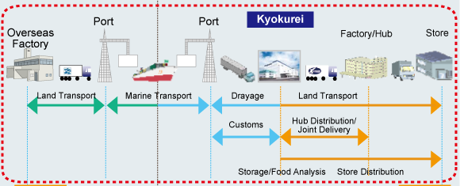
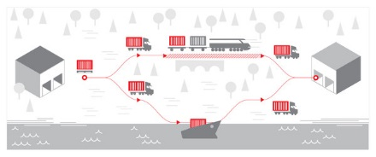
Multimodal vs Intermodal
Multimodal
Intermodal

Slide 27
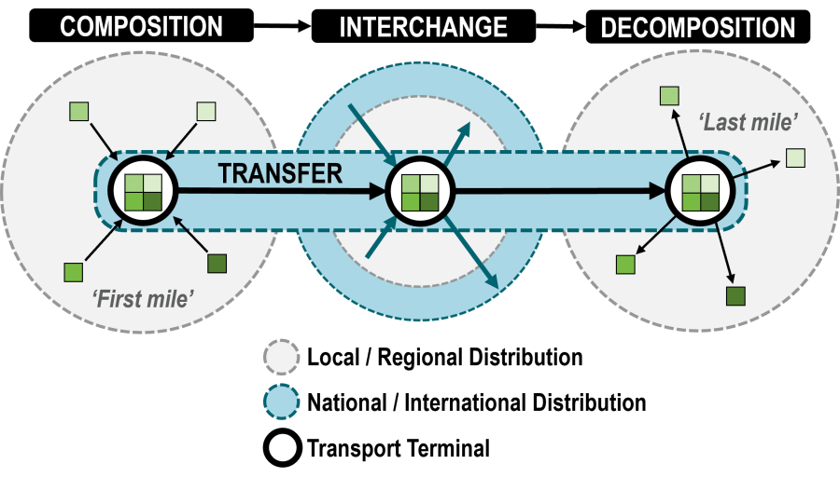
Intermodalism
>Freight distribution is a physical activity and visible to all.
> Intermodal- A way to save the environment and reduce time and cost.
>IFT(Intermodal Freight Transportation) relies heavily on containerization (Bektas & Crainic, 2007) and is operationally efficient and cost-effective ( Lowe,2005).
>Successful promotion of IFT will help to achieve a sustainable freight transport system for a particular country or region.
>Intermodal freight transport has received increased attention due to problems of road congestion, environmental concerns and traffic safety
>To overcome the problems, research is essential on intermodal freight transportation.
>From the transport cost model, an intermodal transport network decreases the average full costs of transportation (Janic, 2007).
>Monios & Wilmsmeier (2013) observed the role of intermodal transport in port regionalization.

Slide 28
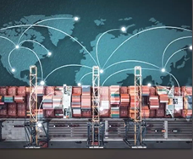
Maritime Ecosystem
The Maritime ecosystem is unique, the oldest and the largest sharing economy in the world.
It is Global, Flat and Self-organized.
Federated and democratic governance
Asset intensive with high demands on optimized resource utilization
Not allowing for one owner
Episodic interactions.

Slide 29
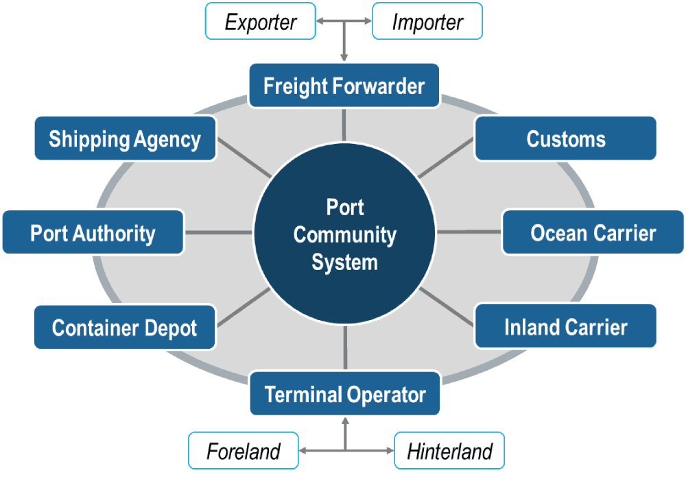
Port Community System
Source: Notteboom et al., 2022
Port users are the main stakeholders of the port community system.
Governance is a big part to be ensured by the respective port authority/government.

Slide 30
Maritime Transformation
From | To
Fragmented Situational Awareness | Common Situational Awareness
Low Information Quality | High and Reliable Information Quality
Lacking Planning Horizons | Predictable Operations
Unstructured Information Exchange | Standardized Data Exchange
Sub Optimized Operations | Mature Collaboration Culture
Unnecessary Waiting Times | Just-In-Time (JIT) Operations
Low IT Maturity | Enhanced IT Systems and Third-Party Innovation Opportunities
Source: Lind, 2024

Slide 31
Key Learnings and Knowledge Management
Transport represents one of the most essential human activities worldwide as it allows us to mitigate the constraint of geography.
It is an indispensable component of the economy and plays a major role in supporting spatial relations between locations.
Transport creates links between regions and economic activities, between people and the rest of the world, generating value.

Slide 32

Q/A

