Slide 1


Date: January 26, 2026 (2.00PM-5.00PM)
Excusive Lecture(2) for
Railway Training Academy, Chattogram
On
Transport Economics
Dr. Razon Chandra Saha
PhD in Transport(BD), Postdoc(Malaysia), MBA in Maritime Mgt.(UK),BSc in Nautical Science
Freight Transport Specialist, Poraka Innovation, Bangladesh.
Adjunct Faculty, Malaysia University of Science and Technology, Malaysia.
Maritime Consultant-Bangladesh - Drewry Maritime Advisory Pte Ltd., Singapore.
Mobile/WhatsApp # +8801712101630, E-mail. razon864@yahoo.com
Web. https://razonchandrasaha.blogspot.com

Slide 2

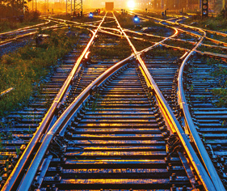
Outline of the Lecture
What is Economics, Transport Economics, Rail Transport Economics?
Inland Transportation Systems.
Key Aspects of Transport Economics.
Applications and Importance of Transport Economics.
The Characteristics and Scope of Transport Economics.
The Analysis of Demand.
Models of Passenger Traffic.
The Analysis of Supply.
Pricing Policies in Transport.
Investment.
Spatial Equilibrium.
Government Transport Policy.
Sea Transport.
The Economics of Airlines.
Key Learnings and Knowledge Management.
Schedule
Lecture-90 Mins
Refresh-10 Mins
Case Study-40 Mins
Group Presentation-20 Mins
Q &A-20 Mins

Slide 3

What is Economics?
Limited
Resources
Unlimited
Wants
The concept of "limited resources and unlimited wants" is the fundamental economic problem of scarcity, which forms the basis of economics itself.
Because resources (like land, labor, capital) are finite and human wants are virtually limitless, societies and individuals must make choices and trade-offs about how to allocate these scarce resources.
This forces economic decision-making, leading to concepts like opportunity cost, which is the value of the next best alternative that is given up when a decision is made
There are two main branches of economics, microeconomics, and macroeconomics.
Microeconomics deals with the behavior of individual households and firms and how that behavior is influenced by government.
Macroeconomics is concerned with economy-wide factors such as inflation, unemployment, and overall economic growth.

Slide 4
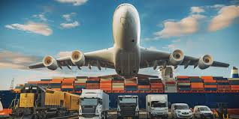

What is Transport Economics?
Transport economics is a field of economics focused on>
resource allocation within the transportation sector,
studying the movement of people and goods
over space and time
to understand
demand, supply, pricing, regulation, and financing of
transport systems.
It analyzes the economic factors influencing transport,
including infrastructure,
vehicle capacity, congestion,
and external costs,
with the goal of improving economic development, trade, and overall societal well-being through efficient transport networks.

Slide 5

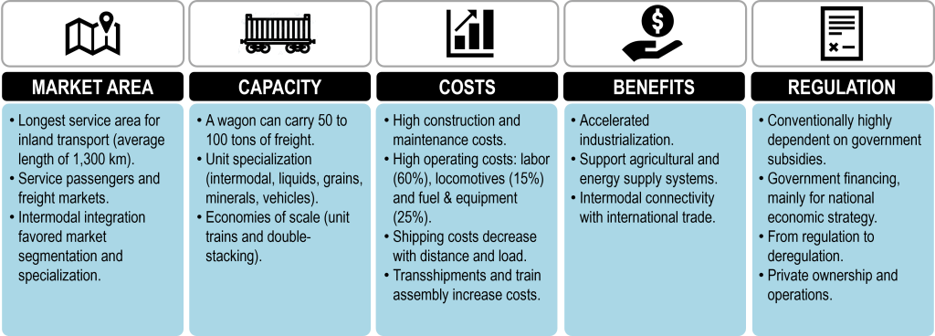
What is Rail Transport Economics?
Efficiently run railways can provide an inexpensive means of transporting high volumes of freight and passengers and improve the competitive positions of shippers and entire economies.
The success of railway depends on the understanding of the economic characteristics of rail and the performance factors that drive financial sustainability. These elements also form the foundation for an effective governance and regulatory environment.

Slide 6
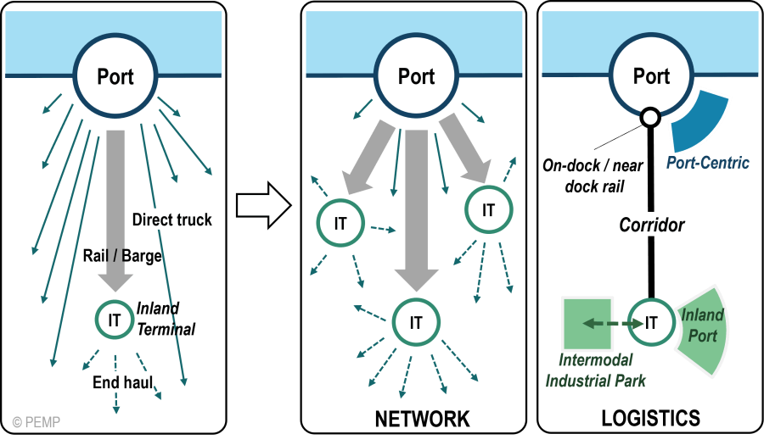
Inland Transportation Systems
Context Bangladesh
Rail-Passenger
Rail-Industrial
Rail-Cross-border
Road-All
Air
Pipeline-Internal
Pipeline-Cross-border
Inland Waterways-Local
Inland Waterways -Protocol
Sea/Port
Many Others
Share your learnings and experiences.

Slide 7
Key Aspects of Transport Economics
Resource Allocation: It examines how scarce resources like land, capital, and labor are used in the transportation sector to meet societal needs.
Demand and Supply: This involves predicting the demand for transportation services (e.g., trips, mode choices) and the supply capacity of transport modes (e.g., roads, rail, air).
Pricing and Regulations: Transport economics analyzes pricing strategies, such as tolls, and the role of government regulation and nationalization versus privatization in the transport sector.
Financing and Funding: It explores methods for financing the maintenance, improvement, and expansion of transport infrastructure, like roads and public transit systems.
Externalities and Congestion: A significant focus is on the negative externalities associated with transport, particularly traffic congestion, which arises from uneven demand and impacts economic activity and well-being.
Economic Development: By facilitating the efficient movement of people and goods, transport economics plays a crucial role in supporting economic development through trade, tourism, employment, and specialization.

Slide 8
Applications and Importance of Transport Economics
Applications
Policy Making: Transport economists provide insights to governments and organizations on how to address challenges in the transport sector, such as infrastructure planning, public transport reform, and sustainable transport.
Infrastructure and Logistics: The field is integral to designing and managing transport networks, including roads, railways, and ports, and in optimizing supply chains and logistics for goods movement.
Academic Study: It serves as a vital area of academic study, with journals and publications dedicated to the economics of transport and its relationship with policy.
Importance
Because effective transportation makes it possible for people and things to move about, facilitates trade, and links companies to markets, it is essential for economic growth and development. This makes transport economics significant.

Slide 9
The Characteristics and Scope of Transport Economics
Transport economics is basically a branch of applied microeconomics.
While it uses many standard techniques of economic analysis, it faces a number of special problems and characteristics that justify its consideration as a specific branch of the discipline.
The demand for transport is a derived one, and each journey is unique in time and space; it cannot be stored or transferred - and from these seemingly simple statements follows a host of implications.
The complexities of economic problems involving transport are illustrated by the controversies over supersonic aircraft, the Third London Airport and motorway construction and by the difficulties posed by road congestion, declining public transport, air traffic control and the vagaries of ocean freight rates.
Technology, with all its expense and uncertainty, has played a critical role, and it will continue to do so as the depletion of oil necessitates a replacement for conventional motor cars.

Slide 10
The Analysis of Demand
The demand for transport and the factors that influence the traveler to choose one mode of transport rather than another.
The importance of analyzing demand hardly needs emphasizing, for in such long-lived investments as motorways, airports, docks and railways the skillful and accurate analysis of demand is a vital element of efficient investment decisions.
Overinvestment is clearly wasteful, but underinvestment can prove expensive to remedy; it is difficult to add an additional lane to an existing motorway, for example .
At the moment the demand for motor cars and motor travel dominates the pattern of travel, and so we shall devote some attention to demand studies; but modelling the total demand for travel and the way in which it is split among different modes has grown in importance recently
Now, it is a vital part of transport planning as per demand analysis.

Slide 11
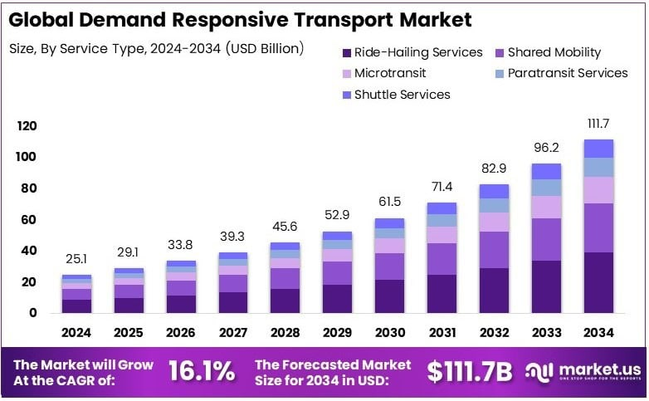
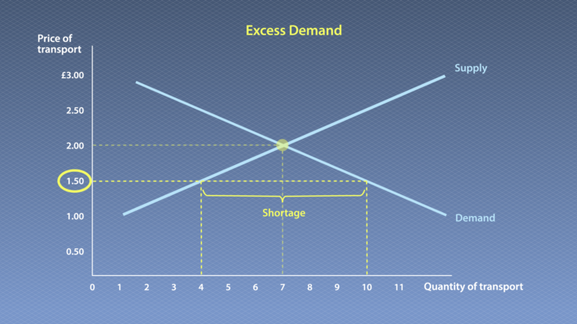
The Analysis of Demand-Graph
Notes: Population growth is the main cause for transport demand. Income generation by all.
Transport demand is seasonal even variation occurred in a day, particular a day( Official
Time)
Excess Demand is not equal to excess supply, excess supply is limited ( Train).

Slide 12
Models of Passenger Traffic
Two principal limitations affect an individual's travel behavior.
First, travel demand, unlike the demand for other commodities, is a 'derived demand'; travel is normally demanded not for its own sake but as a means of consuming some other good or service.
A trip may be made because a household member wishes to buy commodities or service or to obtain other satisfactions (e.g. to purchase food, to visit friends, to earn income).
Second, in the short run the travel decisions of the individual are subject to his residential location, workplace, car ownership or availability , and the availability of various modes at his residential location.
However, in the long run factors such as location and car ownership are also decision variables.
Furthermore, the attributes of the transport system may influence these decisions. Conventional demand modelling has treated travel demand and locational decisions as independent phenomena, at least in the sense that there is no feedback from one to the other.
Consequently, it has been impossible to provide reliable forecasts of the effects of changes in transport system attributes on travel demand, without taking into account at the same time the effects of changing location.

Slide 13
The Analysis of Supply
Costs are incurred in purchasing factors of production for use as inputs in the production process.
The cost of producing any particular output depends on two factors : the technical relationships between the quantities of inputs and outputs (the production function), and the economic relationships between the quantities of inputs and their prices.
Thus, the two sets of relationships combine to give one relationship between the quantity of output and the cost of producing it, which comprises the firm's supply function.
However, because the first set of relationships (between quantity of inputs and quantity of outputs) varies from industry to industry (and for that matter among product groups within an industry) it is not possible to have a universal 'theory of costs' that is applicable to all industries.
Largely as a result of the characteristics of its production functions the transport industry represents a special application of the theory of supply.

Slide 14
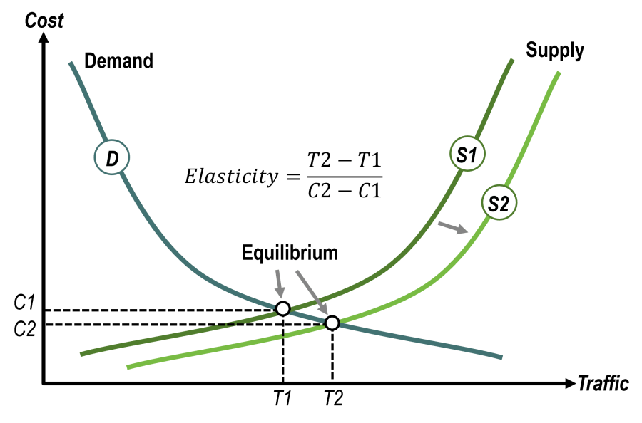
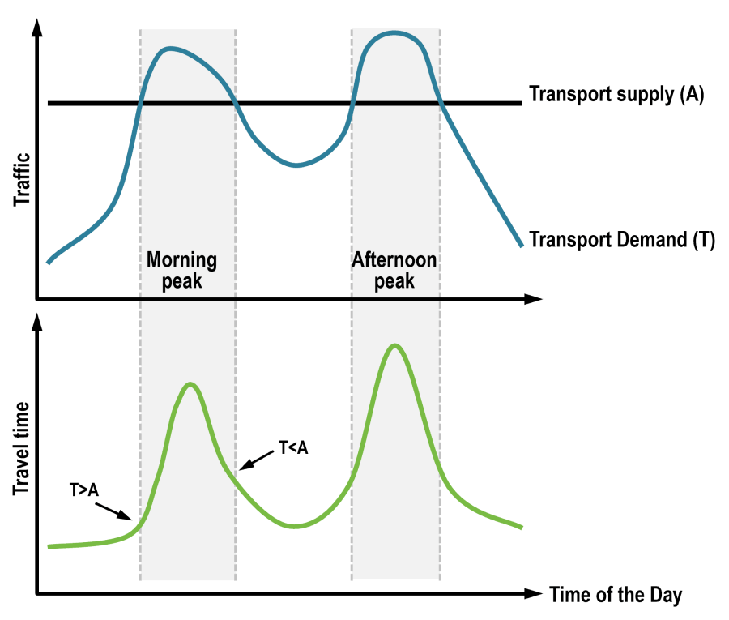
The Analysis of Supply-Graph
Notes:

Slide 15
Pricing Policies in Transport
Prices play a key role in resource allocation.
They are particularly important in transport because it is an intermediate good used in the production of almost every other commodity in the economy.
The subject will be treated in this chapter as follows .
First, pricing principles will be discussed ; then current pricing policies in the transport sector will be analyzed, making a distinction between the pricing of road space and public transport pricing.
With each, current practice will be compared with the principles, and the implications of some suggested modifications will be examined.
Finally , some of the more complex problems of finding the best relationship between the prices of public and private transport will be analyzed.
Attention will be concentrated throughout on matters affecting economic efficiency, and in consequence aspects such as the effects of alternative pricing policies on income distribution will be given only passing mention.

Slide 16
Investment
The importance of investment analysis is obviously critical in transport economics, for the investments are usually long lived and commonly exercise a decisive influence on the way in which communities live and grow.
The essence of such analysis is the comparison of a future stream of receipts from a project with the future pattern of costs, so that a decision can be made on which of several projects is financially most attractive or whether indeed society may prefer to reject all the projects in favor of expenditure elsewhere.
Whether the investment is undertaken privately by an individual or company, or employs public funds, it involves the fundamental issue of choosing allocations for scarce funds.

Slide 17
Spatial Equilibrium in Transport
Spatial problems have been neglected in economic theory, and the field of spatial economics is relatively uncharted.
Historically, the theory of firm location was first developed by Weber (I 909), whose work went unnoticed until Hoover drew attention to it in the later 1940s.
Hoover (I 948) improved many aspects of the theory and introduced a greater measure of reality .
During the 1950s further additions were made to the structure of this theory, of which the most noteworthy contribution came from Isard (1956) who demonstrated the unity of the theory with classical economics-of-substitution analysis and also extended its scope to cover regional analysis.
This led to the development of theories of market areas such as Perroux's (1950) growth poles, which bear a close relation to the work of LOsch ( 1944), who developed the theory of central place in order to explain the empirical regularities of economic regions.

Slide 18
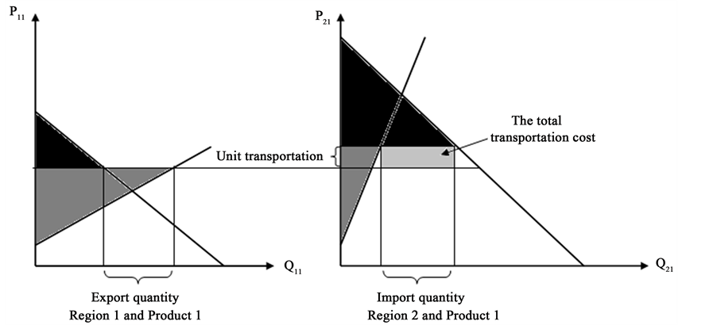
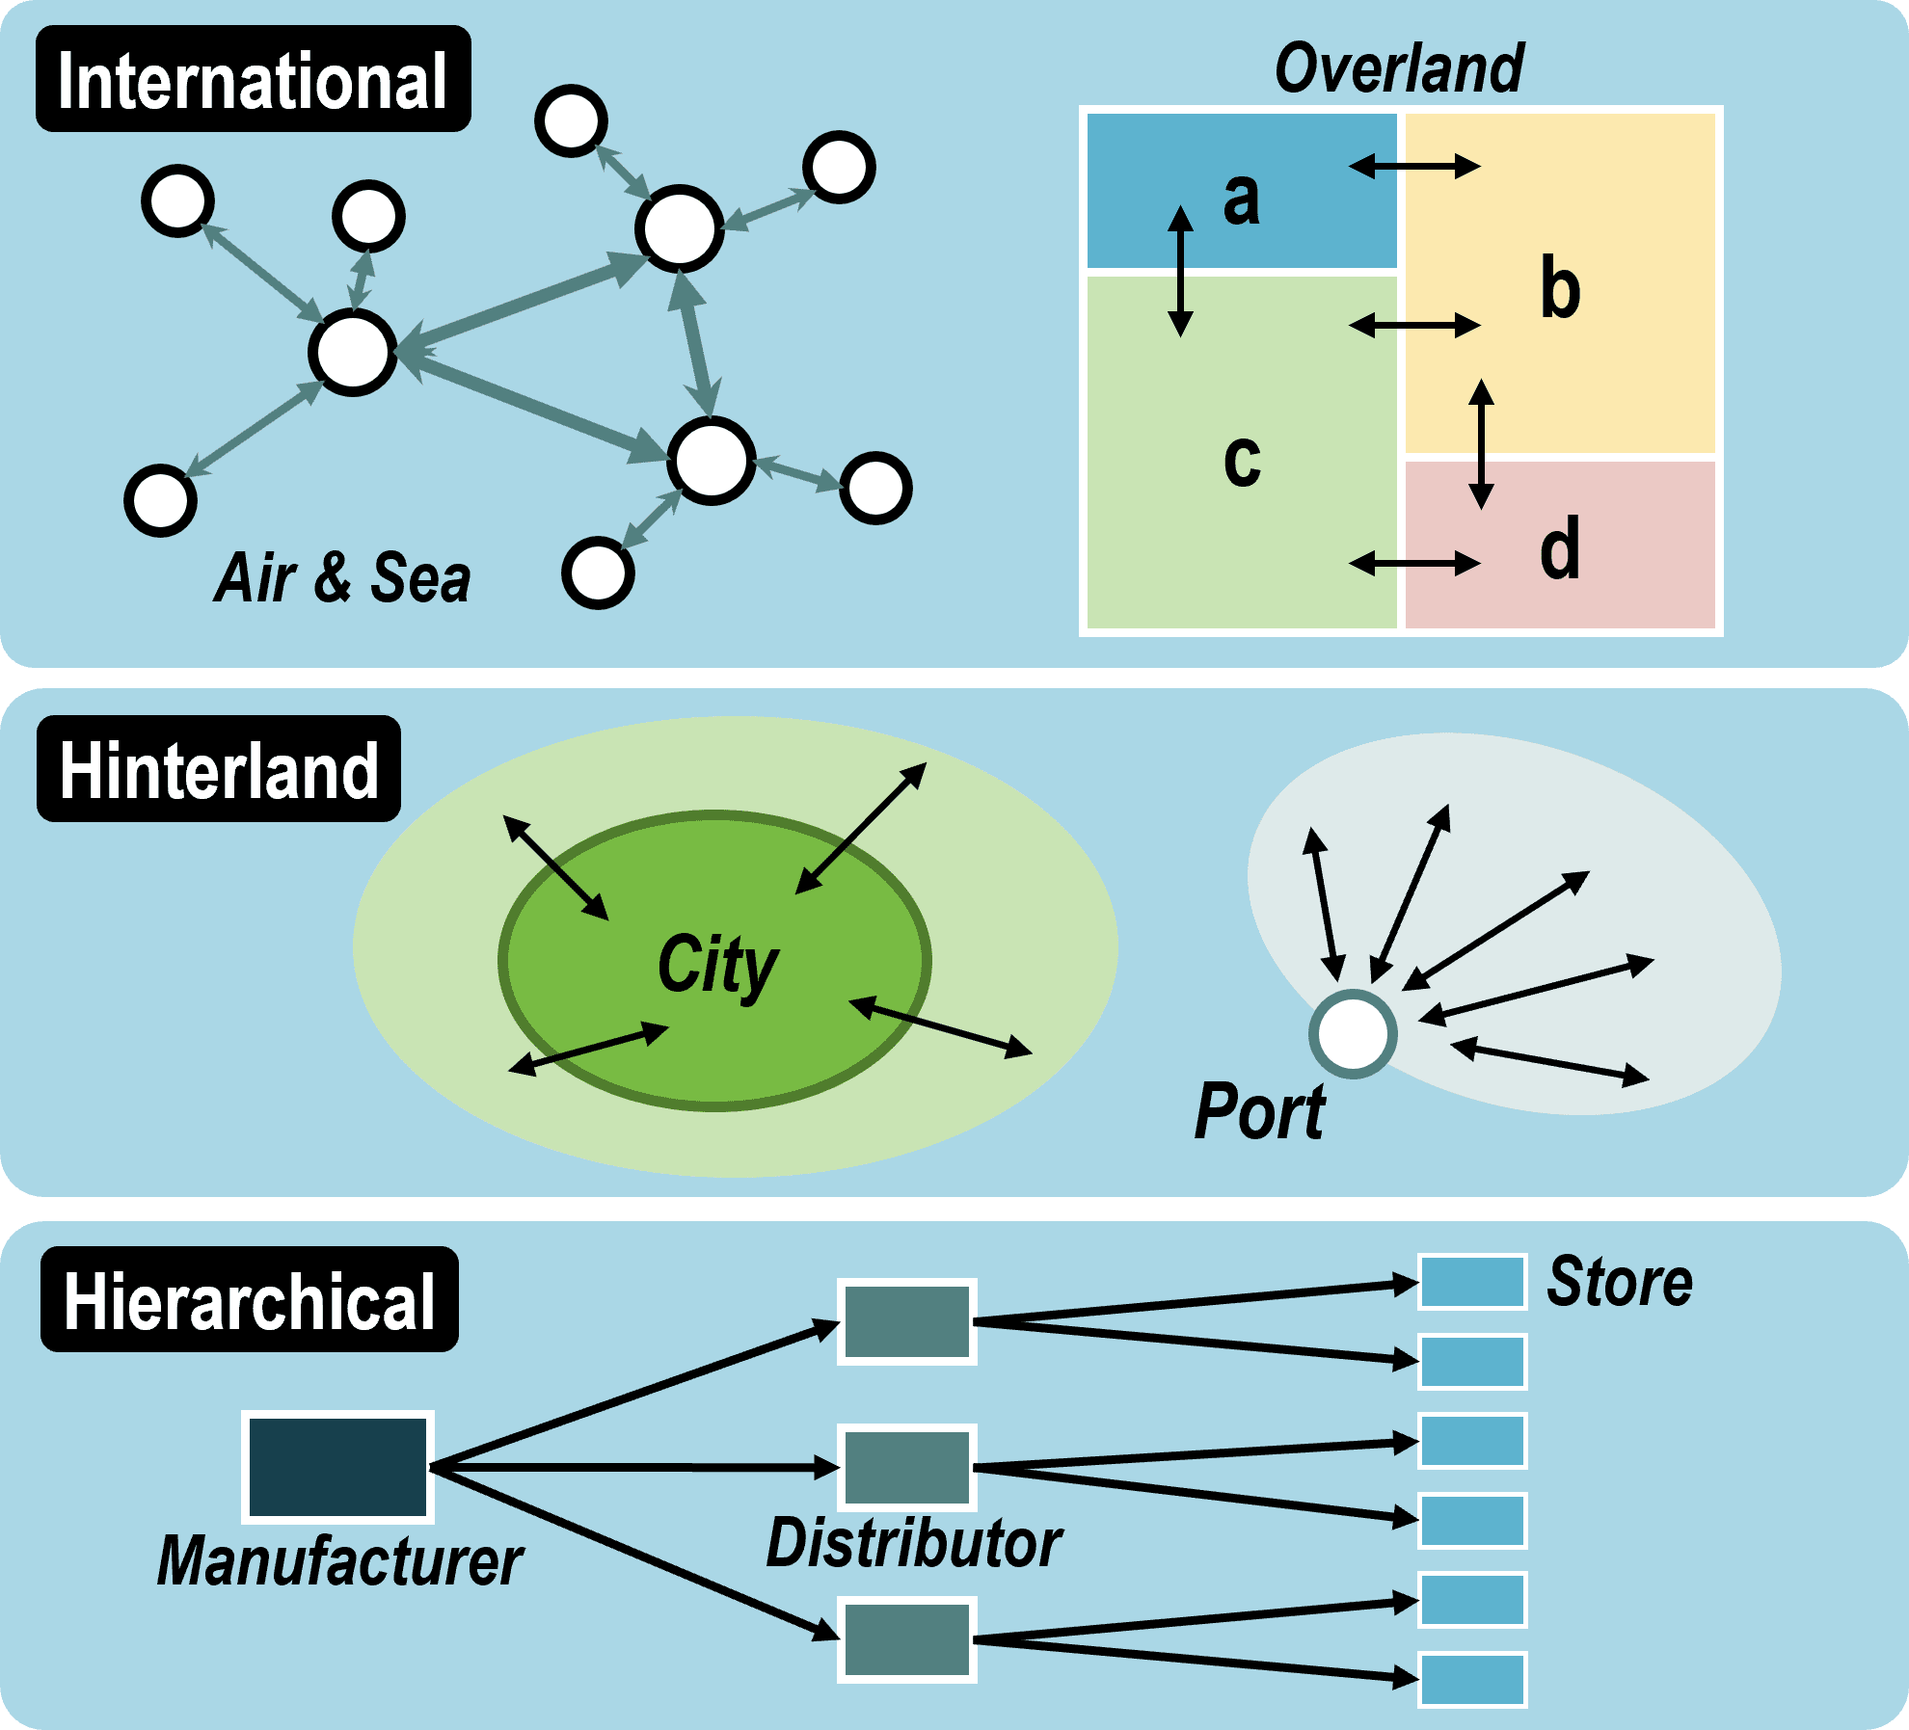
Spatial Equilibrium -Graph
Notes: Extra facilities are good because demand uncertain because of low research.
Freight demand is not fixed, shortage of real data.
Freight hampered to passenger transportation.

Slide 19
Government Transport Policy
The economic problems of transport policy always.
A detailed analysis even of only one country would occupy a book in itself and use advanced areas of economics.
The more modest brief of this chapter is threefold.
First, the scope of government transport policy will be described.
Second, the reasons for government intervention will be analyzed.
Third, an analysis will be made of transport policy in the United Kingdom and an attempt to judge its efficacy.
Although attention will be focused on the situation in the United Kingdom, readers from other countries will doubtless be able to see the areas where their transport policies are similar to and differ from policy in the United Kingdom and, hopefully, to appreciate the rationale for their countries' policies.

Slide 20
Sea Transport or Maritime Economics
Maritime economics is the shipping industry economic unique edition, that covers every section of the sea shipping and economy business.
Sea routes and cargo movements are the main pillars in maritime economics as each started shipment program causes some impact on the international shipping systems.
In macro-economics, the maritime economics addresses the questions of where shipping has come from and where it is now, including sea transport and the global economy, and the economic organization of the shipping market.
Ports are undergoing constant transformation, induced by changes in the global economy, technology, or the environment.
Port reform is influenced by factors that include aspirations for change underpinned by complex internal and external drivers. In a sector where public and private interests must work together, closely managing change is important.
Having the right tools is key for a successful port reform and improvement process which enables economic growth, creates jobs, and fosters sustainable development.

Slide 21
The Economics of Airlines
Aviation facilitates trade, plays an instrumental role in the development of tourism, and provides employment to millions of people.
At the same time, airlines have traditionally been viewed as national symbols, which has resulted in heavy regulation and significant artificial barriers to competition, even in such otherwise open and developed economies as the United States.
Airline Economics is the leading and largest finance & leasing global publication for the aviation sector, reaching industry professionals from lessors, investors, banks, airlines, law firms & others.
he aviation industry supports $4.1 trillion (3.9%) of the world's gross domestic product (GDP). If aviation were a country, it would rank 20th in size by GDP. That is similar to the GDP of Saudi Arabia and equivalent to 1% of global GDP for 2023.
Economies of scope allow airlines to reduce costs by utilizing resources for multiple products and services. For airlines, this includes carrying passengers and cargo on the same flight, operating frequent flyer programs, and providing ground services to other carriers.

Slide 22
Key Learnings and Knowledge Management

Slide 23
Incentive policy for rail-water multimodal transport: Subsidizing price or constructing dry port?
Clues
The impact of incentive policies on the rail-water multimodal transport is inspected.
Subsidy policy can make carriers better off, but may have adverse effects on social welfare.
Subsidy policy expands carrier volume and stimulates transport structure transformation.
Although dry port is conducive to social welfare, it hurts the revenue of carriers.
The dry port is beneficial for achieving long-distance carbon emissions reduction.
Exercise
Impacts of incentives to consider cost, time and environment.
Dry Port establishment and alternative mode development.
Policy requirements to motivate and inspire for modal shift in Bangladesh.
Basic supports of Ministry of Shipping and Ministry of Road Transport and Bridges.
Role of Bangladesh Railway to connect with other modes.
Policy suggestions and recommendations.
Case Study

Slide 24

Q/A

