Slide 1


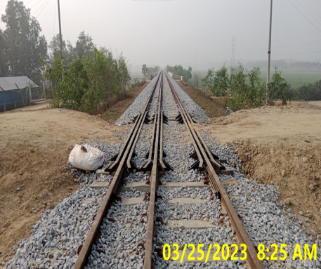
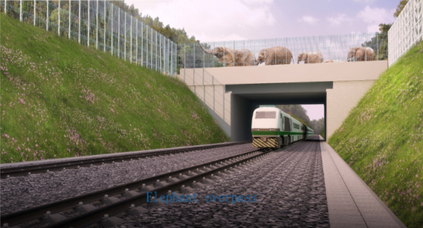
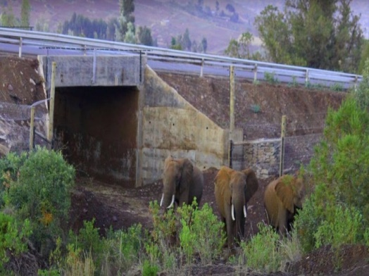
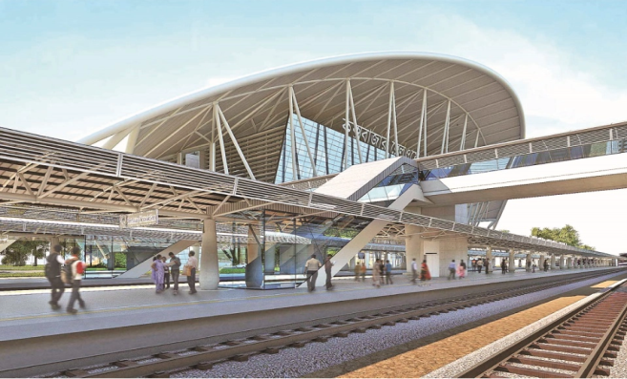

Bangladesh Railway
Welcome to
BR Safety Policy–Practice and Measures Adopted in CCBRP
BR Safety Policy –Practice and
Measures Adopted in CCBRP
Md. Miajahan, Operational specalist
DOHAZARI-COX’S BAZAR RAILWAY PROJECT

Slide 2

Bangladesh Railway
Vision:
To be an Efficient, Reliable, Affordable, and Environment-Friendly
Mass Transportation.

Slide 3
Bangladesh Railway
Mission:
To maintain, upgrade, and modernize the rail system of the country in a manner that supports Government strategies for economic and social development whilst being environmentally and economically sustainable

Slide 4
Bangladesh Railways Network

Slide 5
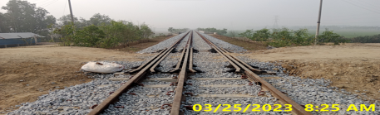



Bangladesh Railway
Background of BR
As an inevitable mode of the surface transport system, Rail communication was first introduced in this part of the Bengal Peninsula in 1862. At the independence of Bangladesh in 1971, we owned a Railway with 2 systems, namely, Broad Gauge (BG) & Metre Gauge (MG) with a network separated by the Jamuna River.
From 15 August 2003, the BR network was interconnected by establishing a Railway link with Dual Gage (DG) over the Jamuna Bridge which is a Real and Bold step towards rationalization of the Railway network. At the end of 2022, Bangladesh Railway covered a length of 3093 route kilometers with 482 stations.

Slide 6


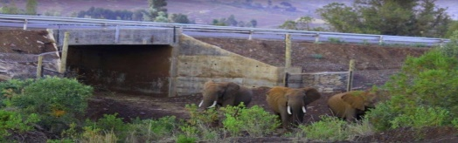

Bangladesh Railway
BR Safety:
Bangladesh Railway system consists of Permanent way (Track), Rolling Stocks (Locomotives, Carriages, etc.), Infrastructures, Manpower & necessary logistics.
Railway operations are guided by the Rules and Regulations [Railway Act-1890 and General & Subsidiary Rules- 1981) that govern
all activities and operations of Bangladesh Railway (BR)

Slide 7




Bangladesh Railway
The Government has an Independent Inspection Department to oversee the Safety of the Railway system which is headed by the Government Inspector of Bangladesh Railway (GIBR).
GIBR is responsible for inspecting and certifying newly constructed Railway section/s (Track, Bridges, Signaling system, Rolling stocks, etc.).
GIBR also inspects the existing Railway network system on a regular basis for ensuring the safe running of trains and the provision of Passenger amenities.

Slide 8

Bangladesh Railway
The ‘Safety aspect of Railway’ is now commonly referred to as the principle of ALARP (As Low As Reasonably Practicable) risk to individual and society.
The present BR Safety practices is sustainably tolerable and will try to obtain a ‘near Zero
fatality level’ in future.

Slide 9
Bangladesh Railway
BR Safety Risks :
The majority of fatalities occurring each year on Bangladesh railways are related to Road vehicles crossing unduly through LCs (Level Crossings), Derailments, Collisions, Trespassers carelessly walking on railway tracks, and suicides.
One table is provided in the next slide.

Slide 10
Year wise Accident and Deaths of Passenger From 2014 to 2019
Passenger Carried ( Millions) | 2014 To 2019 | 2014 67 m | 2015 70.8m | 2016 77.8m | 2017 90.m | 2018 90.5m | 2019 92.5 m
Head on or Side Collision | 4 | 2 | 0 | 1 | 1 | 0 | 0
Averted Collision | 16 | 4 | 3 | 2 | 4 | 3 | 0
Train Parting | 16 | 9 | 1 | 1 | 3 | 2 | 0
Accident at L/C Gates | 96 | 34 | 13 | 11 | 15 | 16 | 7
Signal Disregard | 33 | 8 | 8 | 11 | 4 | 1 | 1
Derailment | 639 | 173 | 116 | 88 | 99 | 121 | 42
Miscellaneous | 173 | 12 | 12 | 17 | 14 | 7 | 2
Total No. of Accident | 868 | 242 | 153 | 131 | 140 | 150 | 52
Deaths (Rail + Roads) | 111 12+99 | 58 4+54 | 13 0+13 | 13 0+13 | 1 0+1 | 17 4+13 | 9 4+5
L/C Gate(81%) | 87.41% | 93% | 100% | 100% | 100% | 76.47% | 66%

Slide 11



Bangladesh Railway
Handling of Safety Breakdowns in BR includes:
* Railway’s own Communication network.
* Operating control in all Divisions linked with
each station and Central Control system.
* Forces with uniform (GRP & RNB). Where needed,
help from local Law enforcing agency is taken.
* An army of gang men spread out all over network.
* Relief Train Team (dedicated Rescue/Restoration team).
* Railway’s own Medical setup.

Slide 12




Bangladesh Railway
(B) Every Railway staff who observes……..
(i) That any signal is Defective;
(ii) Any Obstruction, failure, or Threatened failure of any part of the Way or Works;
(iii) Anything wrong with a train; or
(iv) Any unusual circumstances likely to interfere
safe running of the train or the safety of the Public;
Shall take immediate steps to advise the nearest Station Master by the quickest possible means.

Slide 13
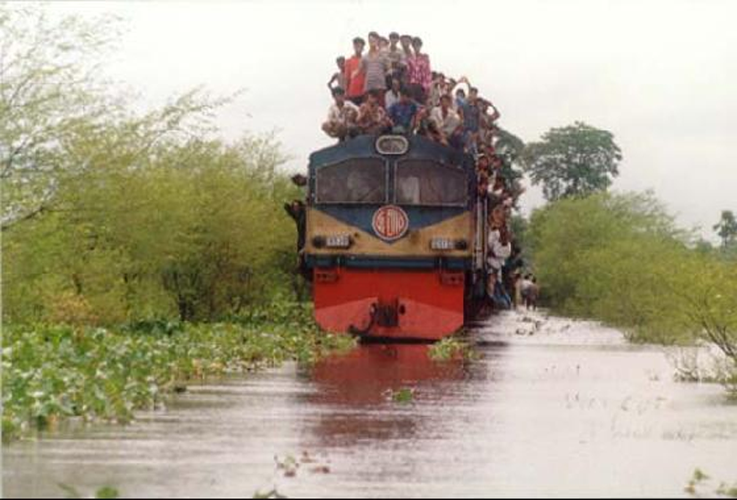
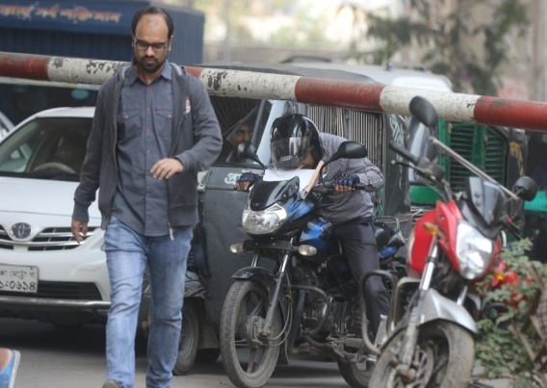
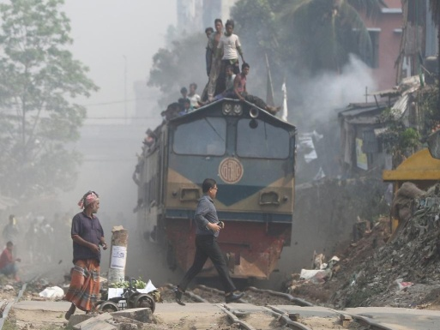
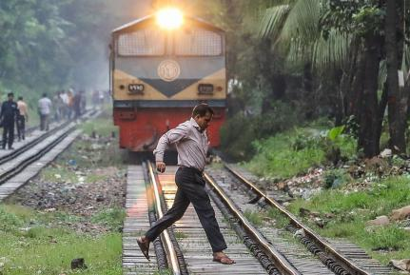
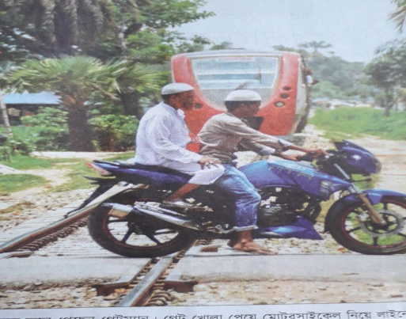
Bangladesh Railway
Train Operation in Hostile Environment
experienced in other sections of BR

Slide 14




Bangladesh Railway
Safety Measures Adopted in CCBRP.
Chattagram- Dhohzari- Cox’s Bazar Railway Project will bring a new Transport system (Railway) to this coastal area where communities will see and experience the Railway system first.
So, the Safety issue is important in the
case of Train operations.

Slide 15



Bangladesh Railway
.
As per Sustainable Development Principles adopted in 2012, Government & Development Partners Emphasis on Social/Economic Sustainability and Environmental Sustainability for natural resources (Land, and ecosystem of natural habitat not to face
any negative impact on Environment) for the Development Projects.

Slide 16
Bangladesh Railway
DCRP is introducing a Natural forest Environment for animals especially Elephant (Passage to move in their own environment) by constructing Rail Track with Over Pass (one), Under Passes (Two), Elephant fencings and Sensor monitoring system.

Slide 17

Bangladesh Railway
Safety ensures by the Computer-based interlocking system at the
Station & Special Class Level Crossing.
Wayside
(Field)
Signal
Electric Point machine
Level crossing (Interlocking)
Junction box
Pot end Box
Wheel Detector for Axle Counter
Track Lead Junction Box(wheel detector cable jointing box)
Signal
Potend
ETC
Block (Token, Tokenless) interface
SMO
JB
Point Machine
Equipment
room
Track Circuit
SMO
Monitoring & Control Computer Rack (MCCR)
Key Transmitter
Equipment room
CBI(CBIR)
Monitoring & Maintenance Computer Rack (MMCR) with Axle counter
Relay, Output Terminal rack
Power Supply & Battery
Gate Lodge
Level crossing
Generator room
Generator

Slide 18
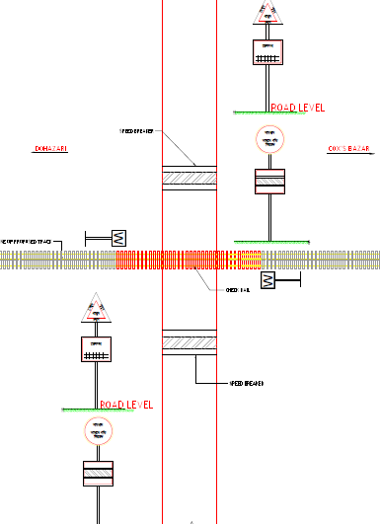
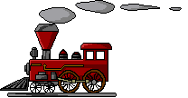
Bangladesh Railway
Bangladesh Railway
`B’ class LC Gate
where Gate Keepers & Barrier Provide,

Slide 19
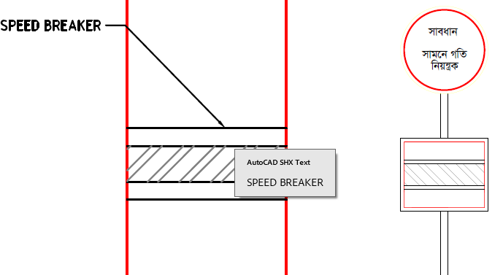
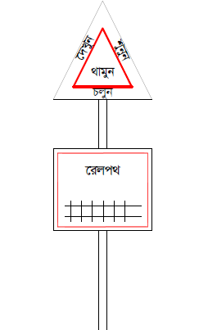
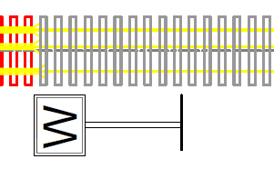
Bangladesh Railway

Slide 20
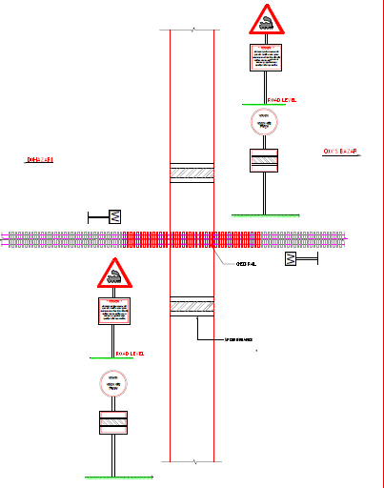
Bangladesh Railway
Bangladesh Railway
`C’ class Level Crossing Gate and Road sign for Vehicle to Safely Cross Railway Track. This type of gate is unmanned and without Barriers.

Slide 21
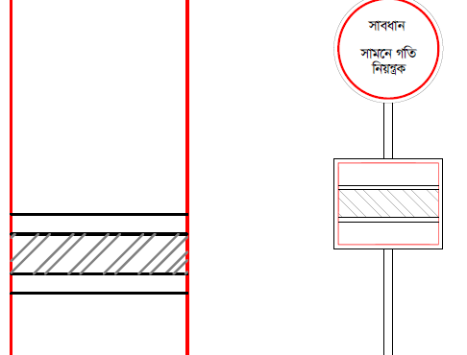
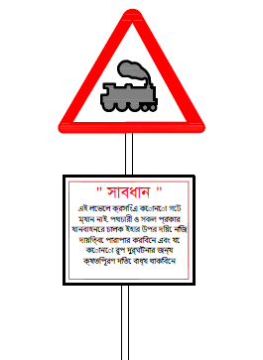
Bangladesh Railway
Caution Notice for
Vehicles &
Pedestrian
Railway Track Side Whistle Board
Where Approaching Trains Whistle for Alertness of Gate and Waiting Vehicles & Pedestrian

Slide 22




Bangladesh Railway
# For Rail users at all stations, FOBs (Foot Over
Bridges) are provided so that passengers can safely
switch over to another platform.
# Every FOB has a ramp for Disabled people.
# All platforms are provided with Special type of Tiles to guide the Blind (handicapped) persons.

Slide 23



Bangladesh Railway
Status of Action Plan of Awareness safety campaigns :
As communities of the Project area will experience a new Transport system, it has been planned to conduct ‘Rail Crossing Safety Awareness Campaign’ along the corridor (People of all sections, School children, Vehicle Drivers, etc.)
This awareness program will be implemented jointly BR, ADB, NGO (Specialized safety Awareness) & PMC.

Slide 24




Bangladesh Railway
Objectives of Awareness safety campaigns:
To develop a vocabulary of the Rail Track environment.
To particularly understand the distinction between pedestrian
and traffic.
• To understand the features of various Rail users.
To understand that many things are dangerous on the Railway
Track.
• To think and talk about LC mishaps/accidents.
• To realize that mishaps are avoidable

Slide 25



Bangladesh Railway
Way Forward to Ensure the Safety of BR
1. Need to set competent Operating staff at all levels.
2. Need to maintain safe Track, Rolling Stocks, Signaling
system, etc.
3. Need to Conduct regular inspections necessary to
prevent accidents and loss.
When these will be done, Railway will be more safe.

Slide 26

Bangladesh Railway
Thanks for Active
Participation

